Slide 1
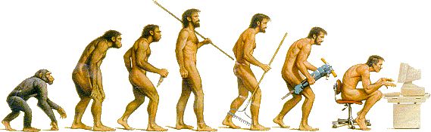
Object-Oriented Programming
Using C++
Zhaopeng Cui
http://www.cad.zju.edu.cn/home/zhpcui/

Slide 2
Course Contents
Introduction to object-oriented programming (OOP)
…with a strong software engineering foundation…
…aimed at producing and maintaining large, high-quality software systems.

Slide 3
Object-oriented programming
computers are not so much machines as they are mind amplification tools and a different kind of expressive medium. As a result, the tools are beginning to look less like machines and more like parts of our minds, and also like other expressive mediums such as writing, painting, sculpture, animation, and filmmaking. Object-oriented programming is part of this movement toward using the computer as an expressive medium.

Slide 4
Buzzwords
responsibility-driven design
Encapsulation (封装)
Inheritance(继承)
iterators
overriding
coupling
interface
cohesion
template
collection classes
mutator methods
Polymorphism(多态)
polymorphic method calls

Slide 5
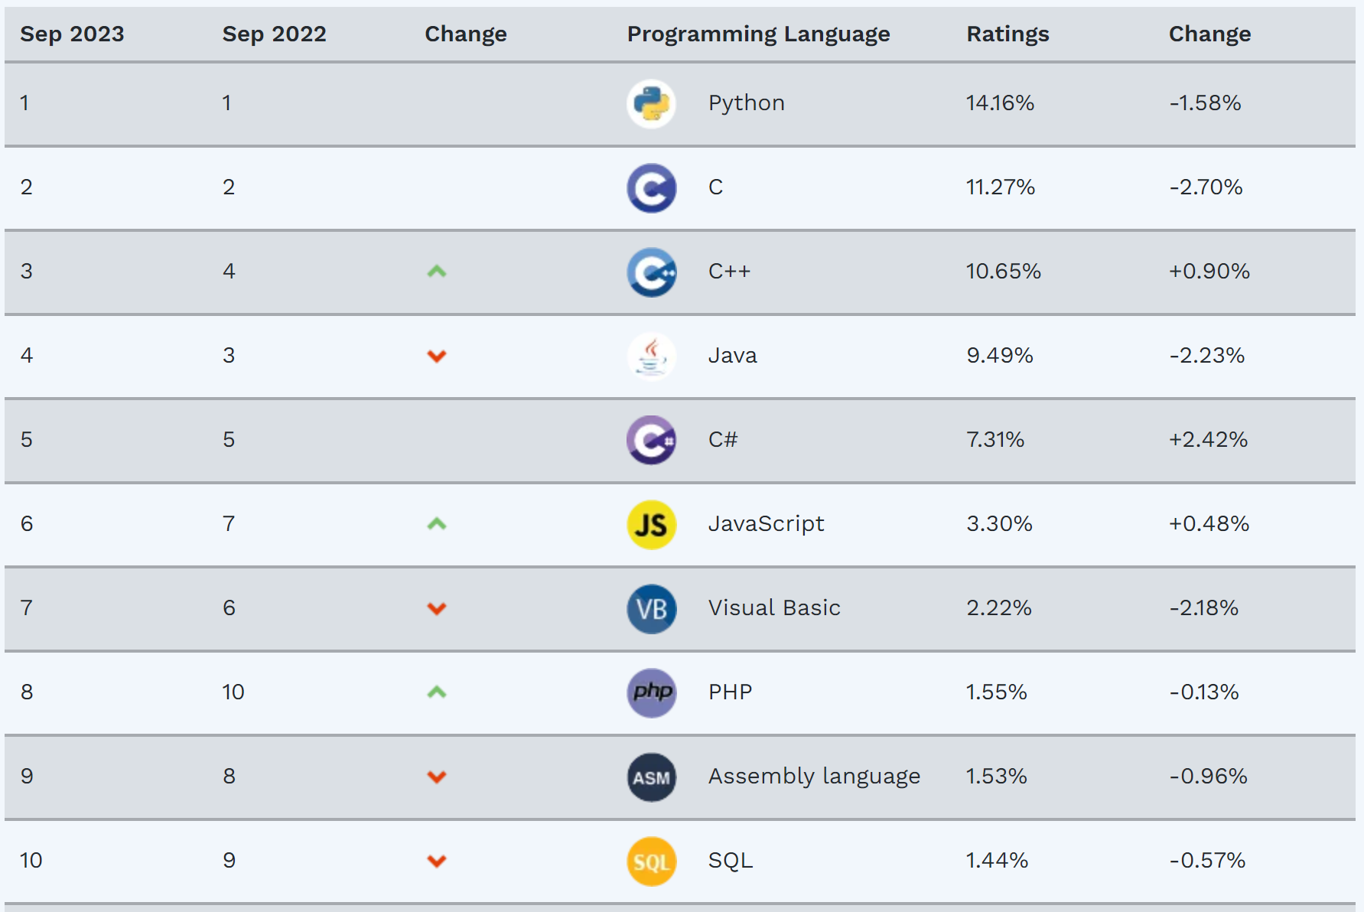
Ranked 3rd on TIOBE Index

Slide 6
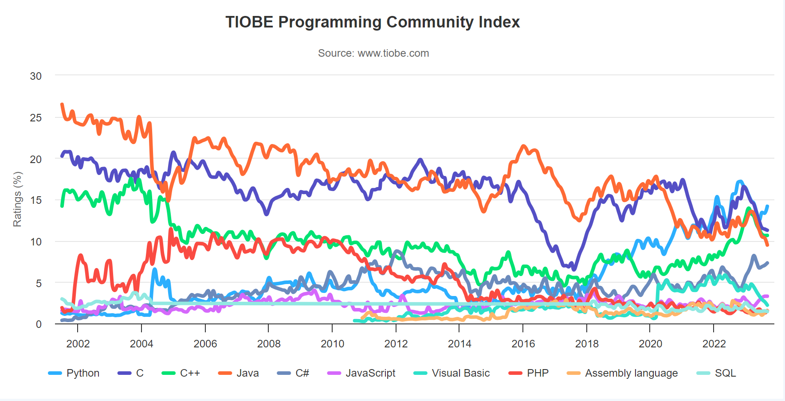
Ranked 3rd on TIOBE Index

Slide 7
其他语言？
现代的编程语言在语法上的差异很小、
几乎都是C-like语言
语言的能力/适用领域主要由
库 and
传统所决定

Slide 8
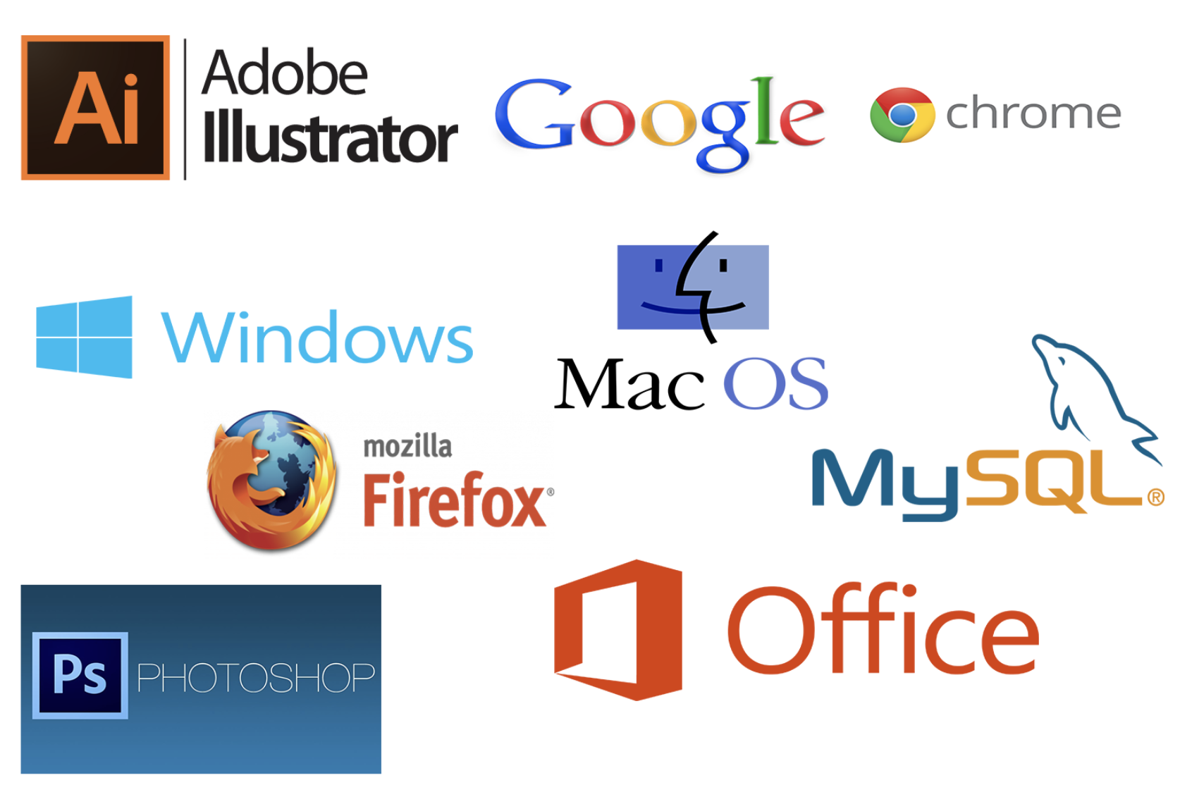
C++ Applications

Slide 9

C++ Applications

Slide 10
C++ Applications

Slide 11
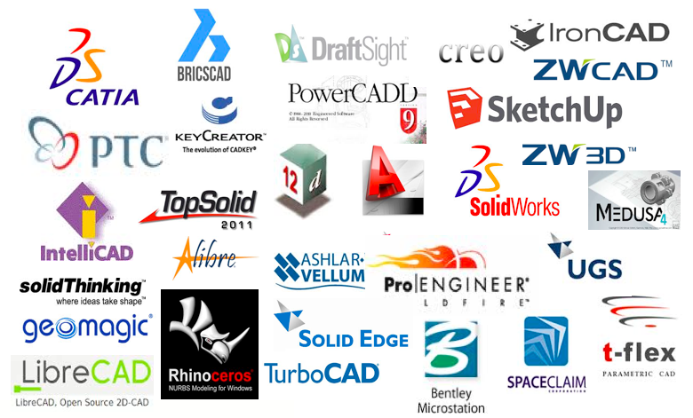
C++ Applications「卡脖子问题」

Slide 12
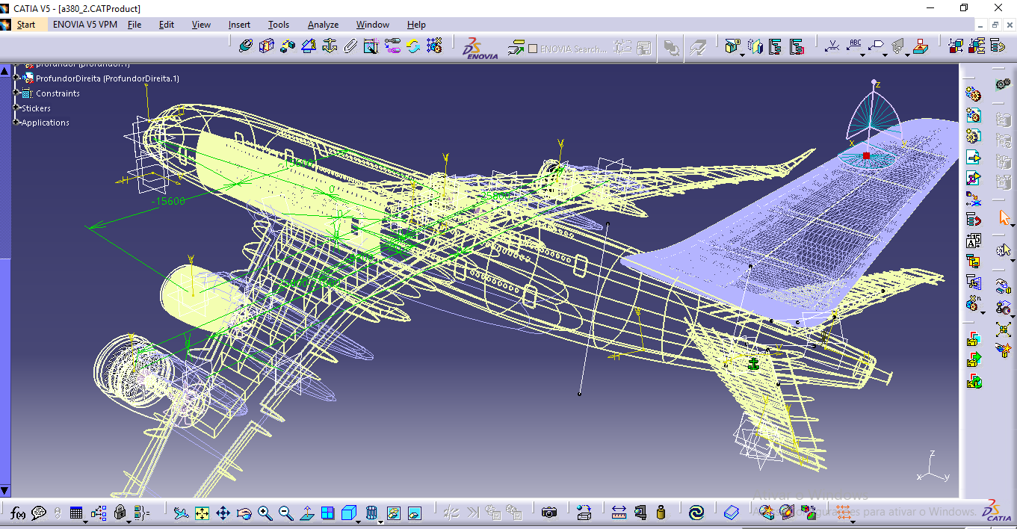
C++ Applications「卡脖子问题」

Slide 13
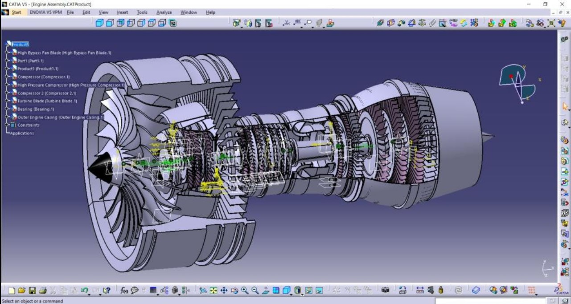
C++ Applications「卡脖子问题」

Slide 14
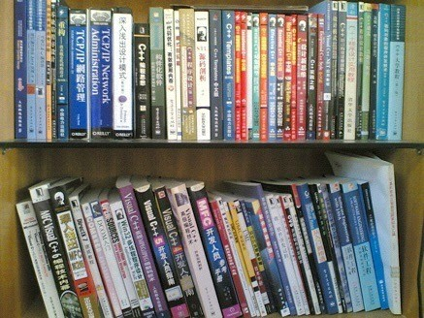
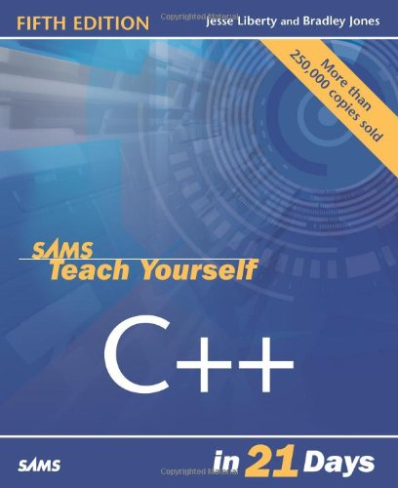
Textbooks

Slide 15
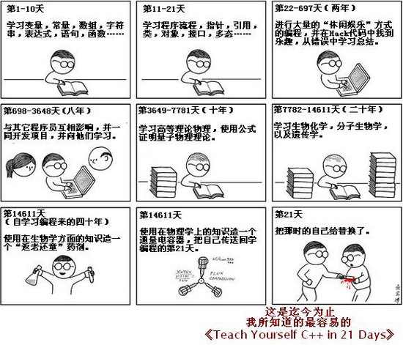

Slide 16
Textbooks
Thinking In C++, Ver. 2,Vol. 1 & 2
C++ Primer, Ver 5
References:
• The C++ Programming Language
• C++:The Core Language
• Essential C++
• Effective C++
• Inside the C++ Object Model
• C++ Templates

Slide 17
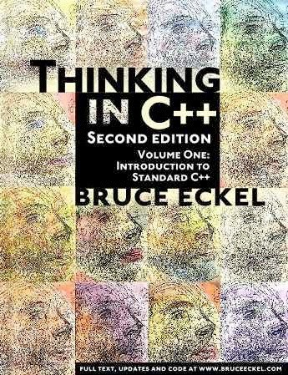
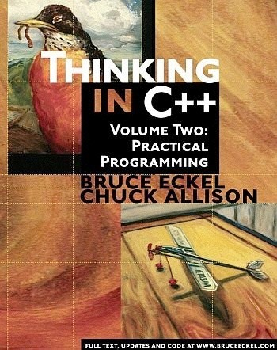
C++编程思想 机械工业出版社

Slide 18
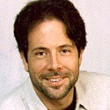
Bruce Eckel
BRUCE ECKEL is the author of “Thinking in C++”, which won the Software Development Jolt Award for best book of 1995. He's been professionally programming for 20 years and has been teaching people throughout the world how to program with objects since 1986. He was a voting member of the C++ Standards Committee.
http://mindview.net
6

Slide 19
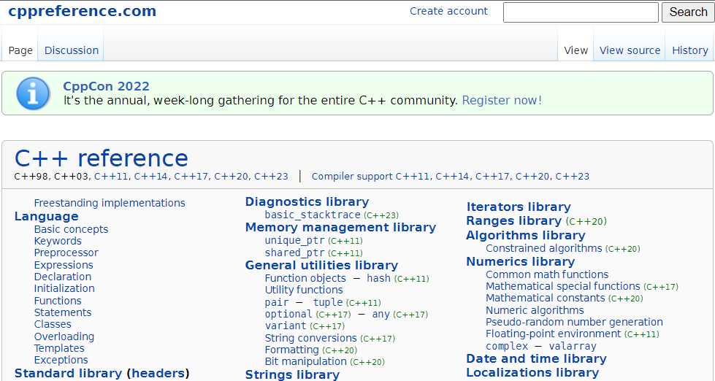
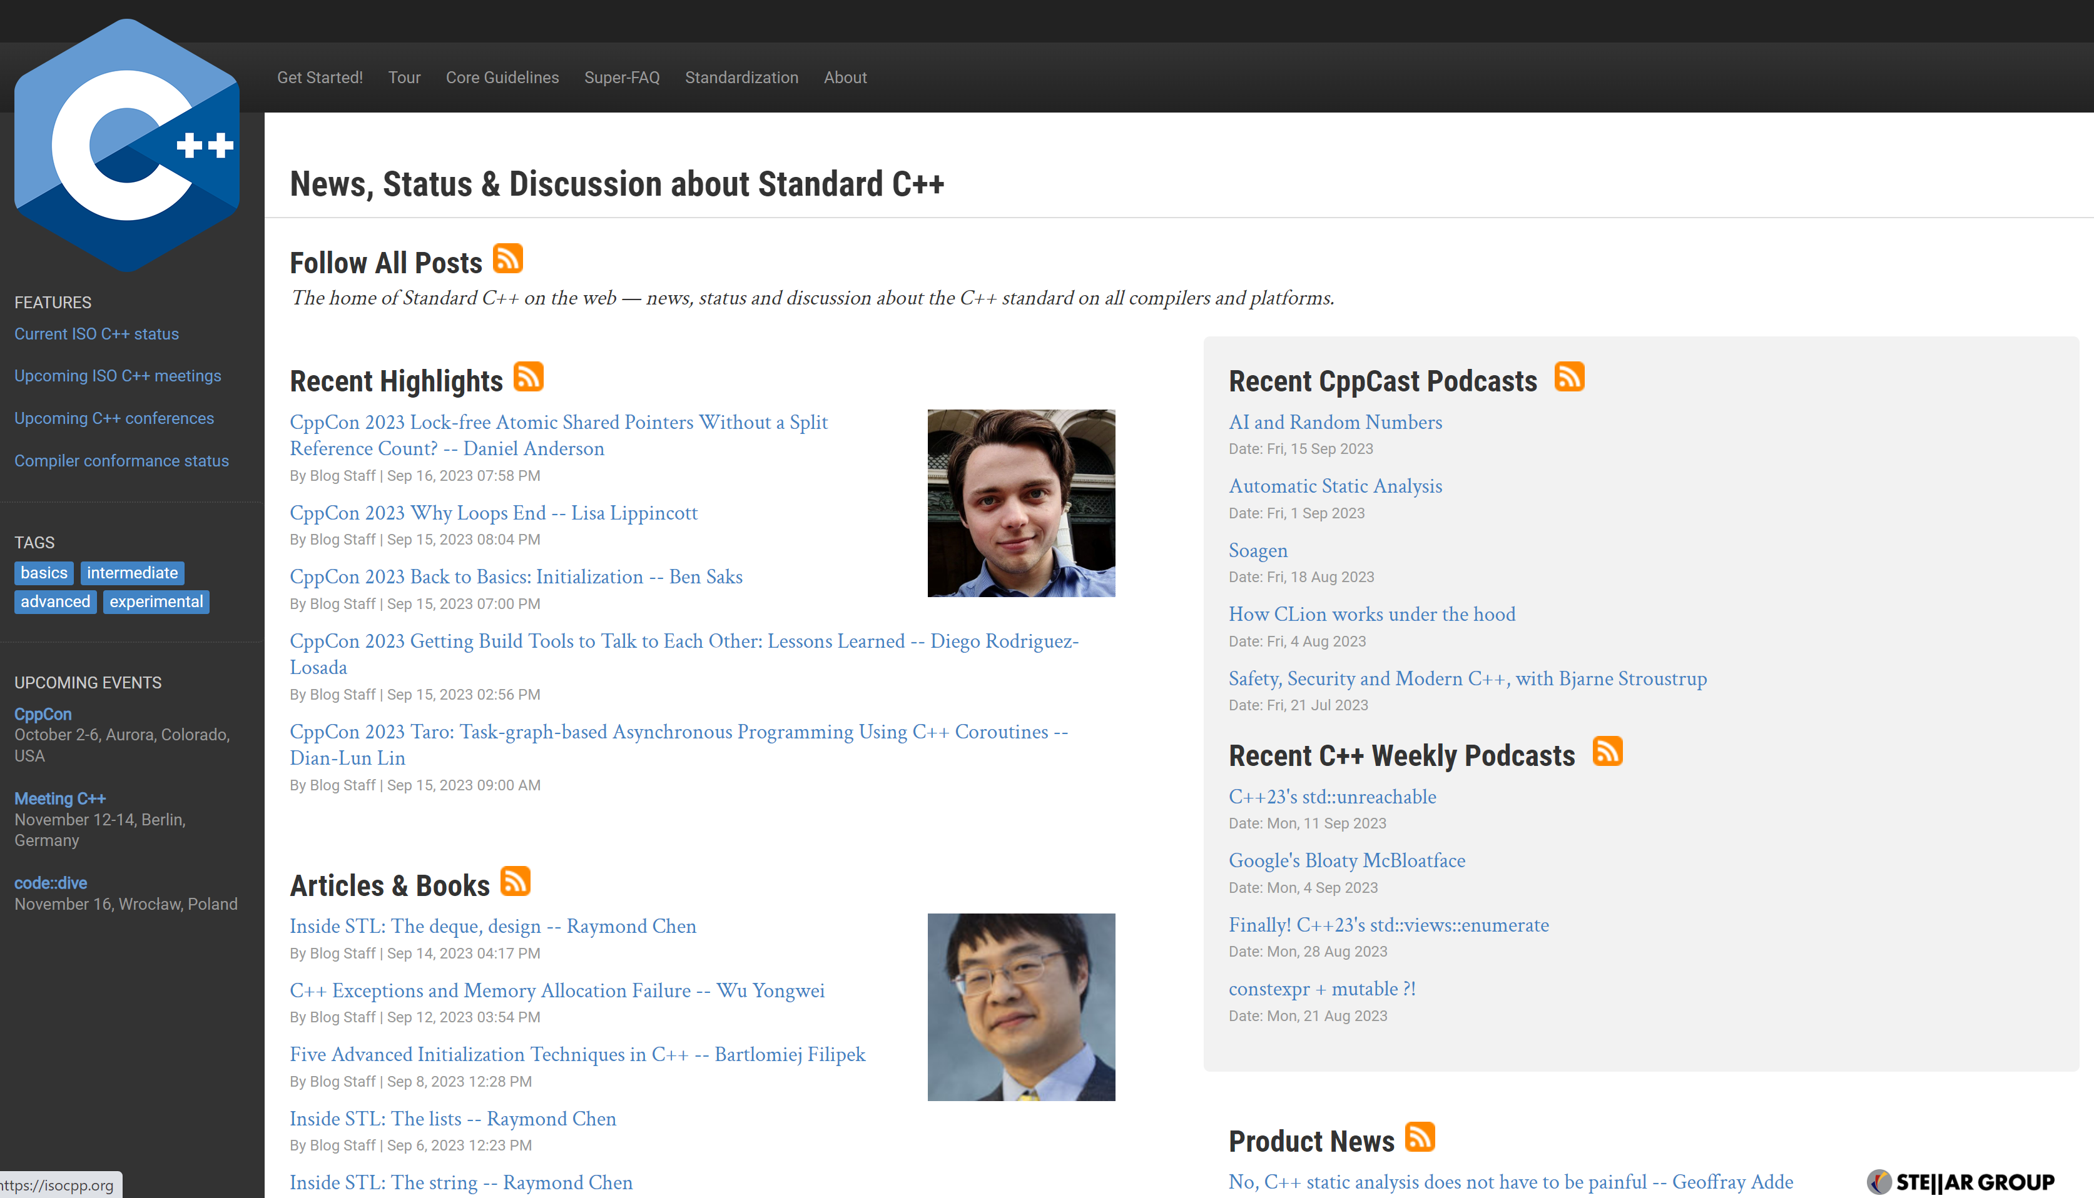
Online Resources for C++
https://cppreference.com
https://isocpp.org/
https://www.youtube.com/user/CppCon

Slide 20
Assessment
1. Lab: 50% (including the in-class quiz)
! In week 2, 4, 6, 8, 10, 12, (14, 16)
To submit on-line, to be judged manually
Deadline is DEAD on Midnight of Saturday of (week 3, 5, 7, 9, 11, 13, 16)
Per day delay cost: 10% of the full score
2. Final exam: 50%, on PTA

Slide 21
Resources
课件PPT：
https://course.zju.edu.cn (学在浙大)
作业：
https://pintia.cn (PTA)
面向对象程序设计2023-2024秋冬习题集

Slide 22
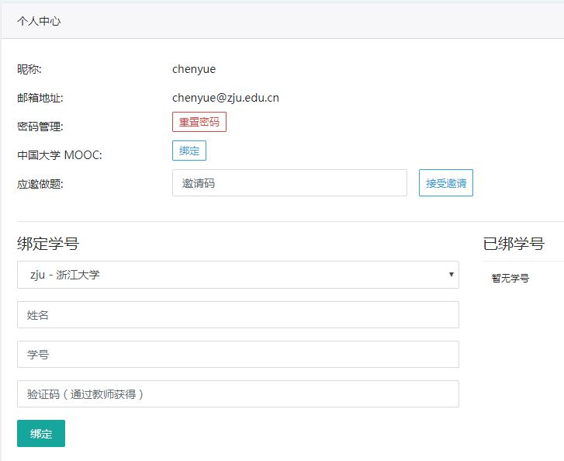
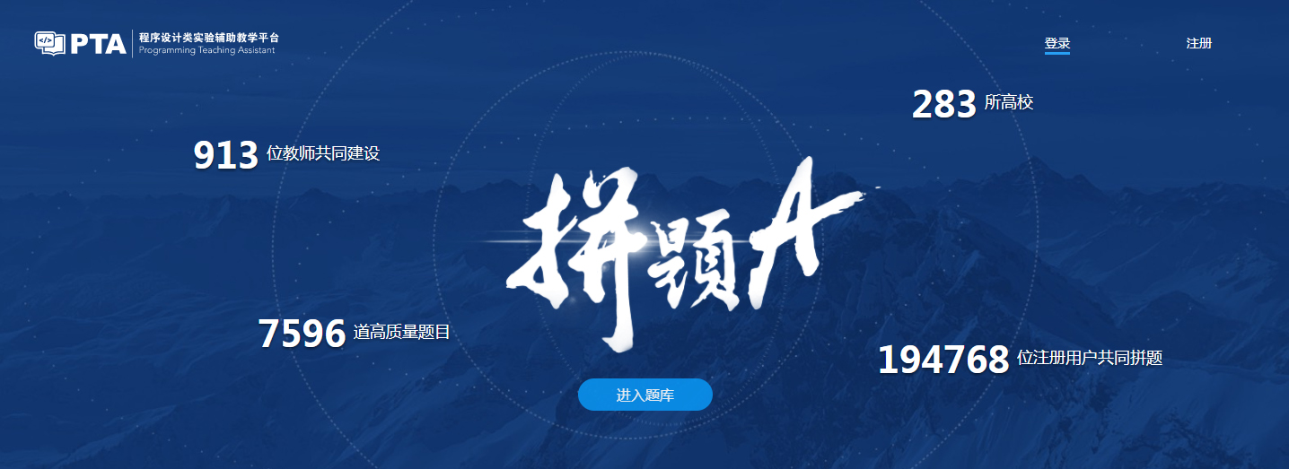
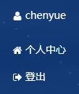
作业 (Homework Assignments)
Register and login at https://pintia.cn/
Bind your student ID with bind key
Enter

Slide 23
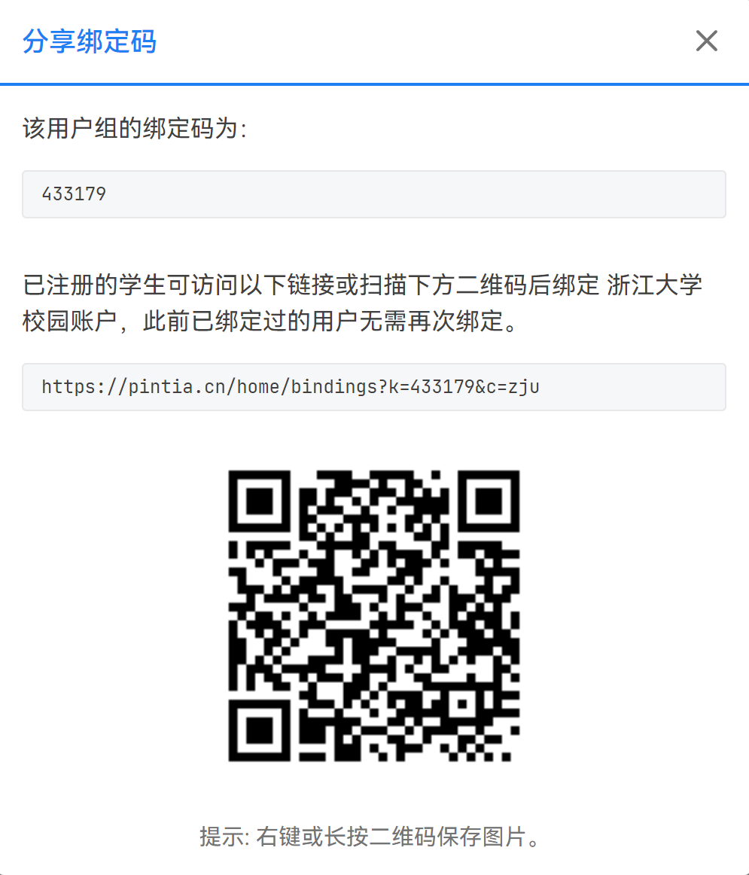
PTA绑定码：433179

Slide 24
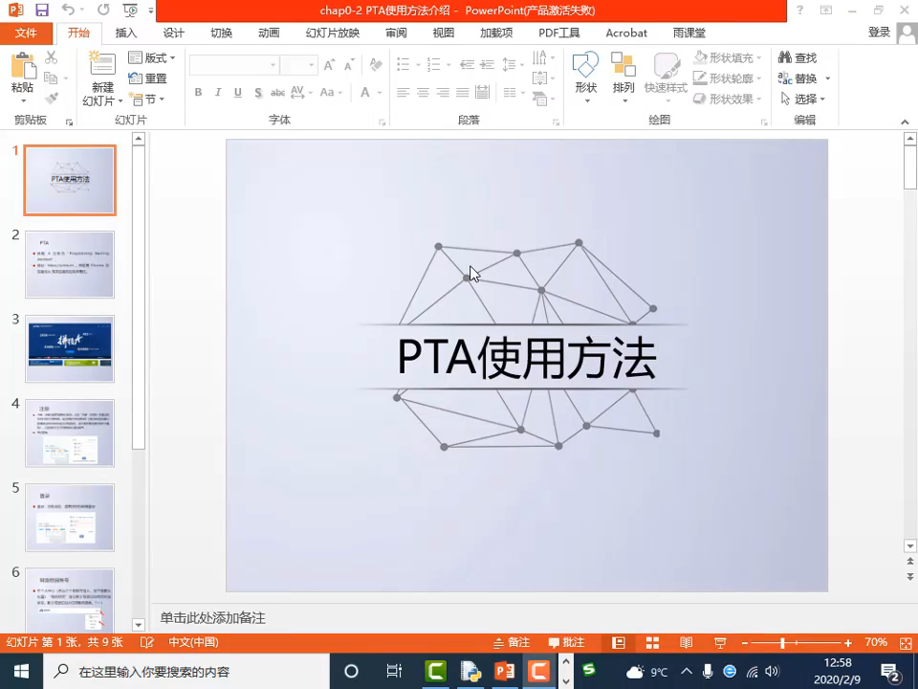

Slide 25
Course policy
Academic honesty:
Students are fully responsible for their actions.
During homework, students can help each other through hints and explanations.
Copying code from anybody else is strictly forbidden.
https://conduct.berkeley.edu/integrity/

Slide 26
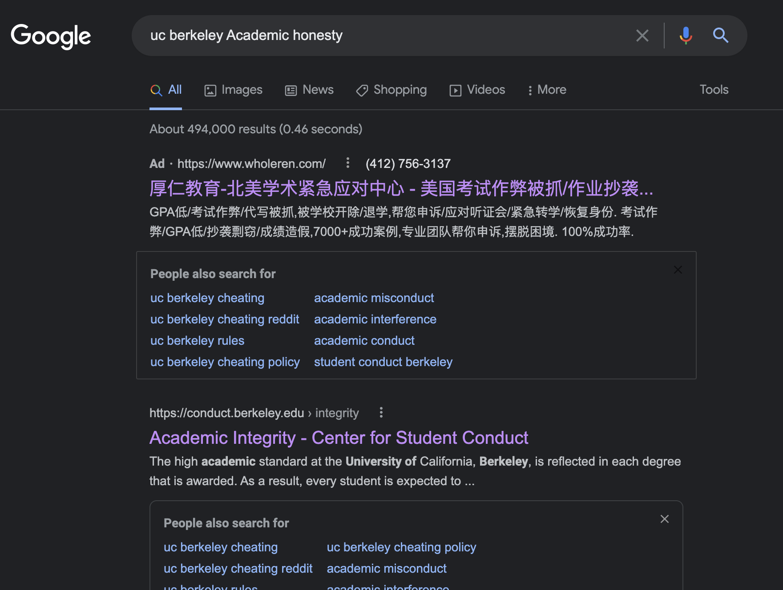
Course policy

Slide 27
E-mail rule
Contact info:
DingTalk (钉钉)
oop_zju@163.com / zhpcui@zju.edu.cn
Title starts with "[OOP]"
State your name and id in the text
Prefer plain text e-mail
NO background, music, color, font styles..

Slide 28
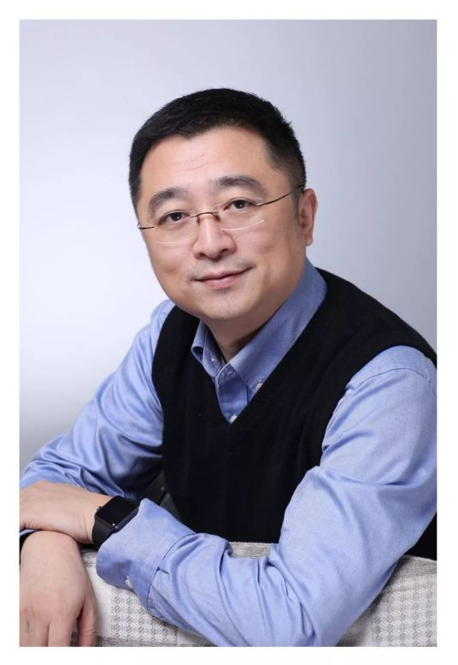
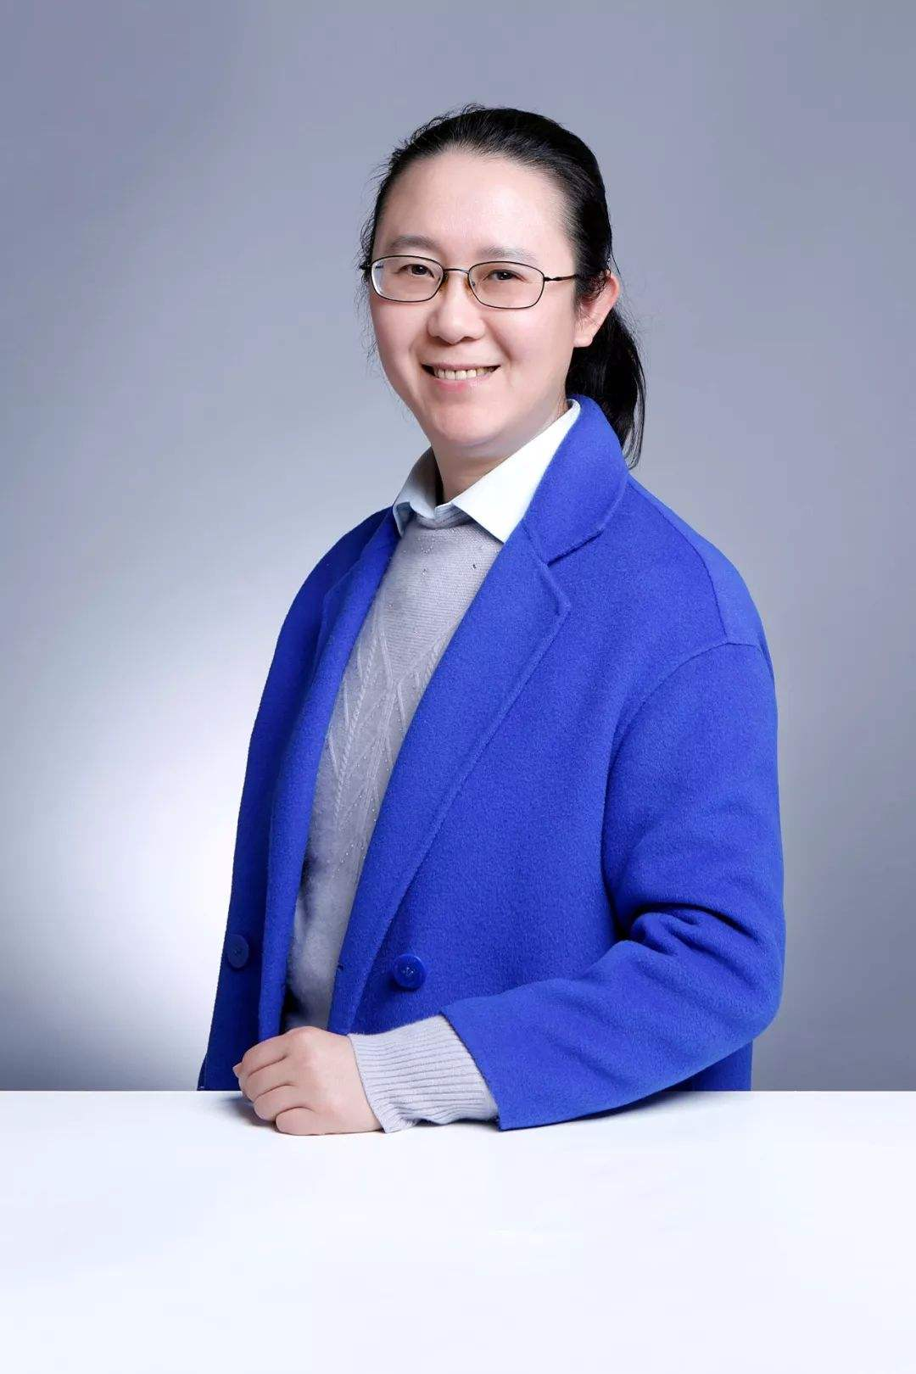
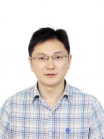
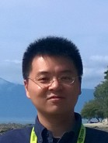
Acknowledge
翁恺
陈越
许威威
陈翔

Slide 29
Introduction to C++
The trip begins…

Slide 30
The First C++ Program
#include <iostream>
using namespace std;
int main()
{
cout << "Hello, World! I am " << 18 << " Today!" << endl;
return 0;
}

Slide 31


Development environment
Windows:
visual studio
Linux, macOS:
g++, clang
visual studio code
Any compiler supports C++ standard well…

Slide 32
Read input
#include <iostream> using namespace std;
int main() {
int number;
cout << "Enter a decimal number: "; cin >> number;
cout << "The number you entered is " << number <<"." << endl;
return 0;
}

Slide 33
The C Language
Strengths
Efficient programs
Direct access to machine, suitable for OS and ES
Flexible
Weakness
Insufficient type checking
Poor support for programming-in-the-large
Procedure-oriented programming

Slide 34

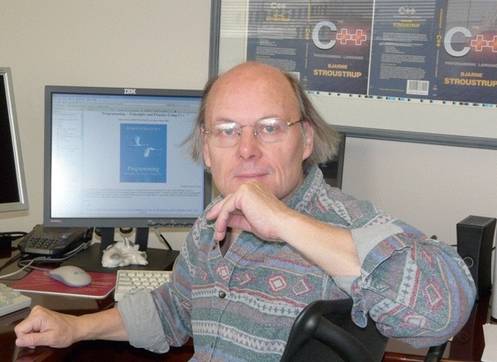
Bjarne Stroustrup
C++ was first designed and implemented by Bjarne Stroustrup, AT&T, early 1980’s
http://www.stroustrup.com/

Slide 35
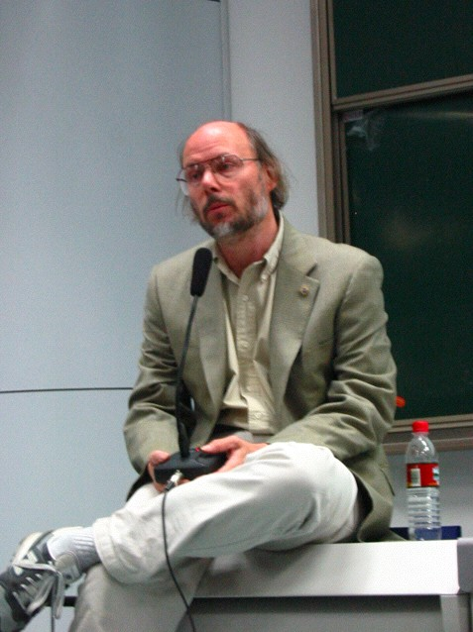
Oct. 2002, Stroustrup visited Zhejiang Univ.

Slide 36
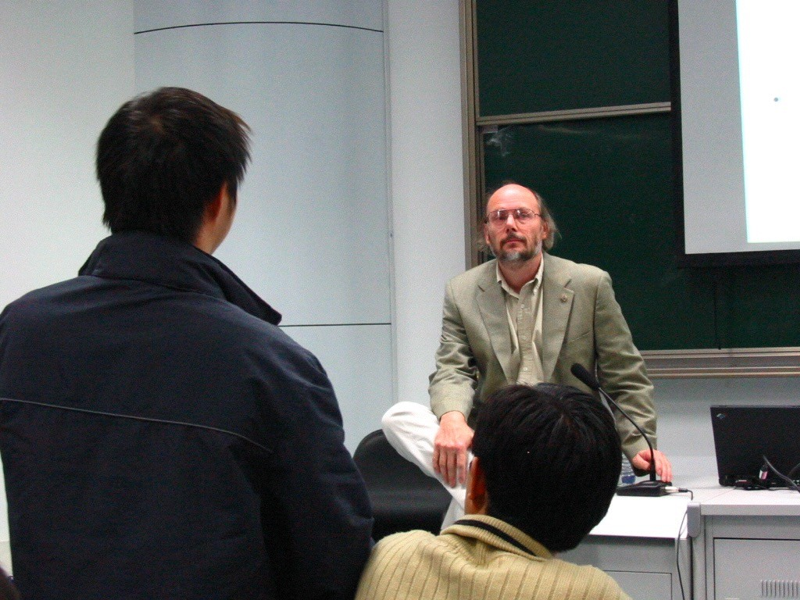

Slide 37
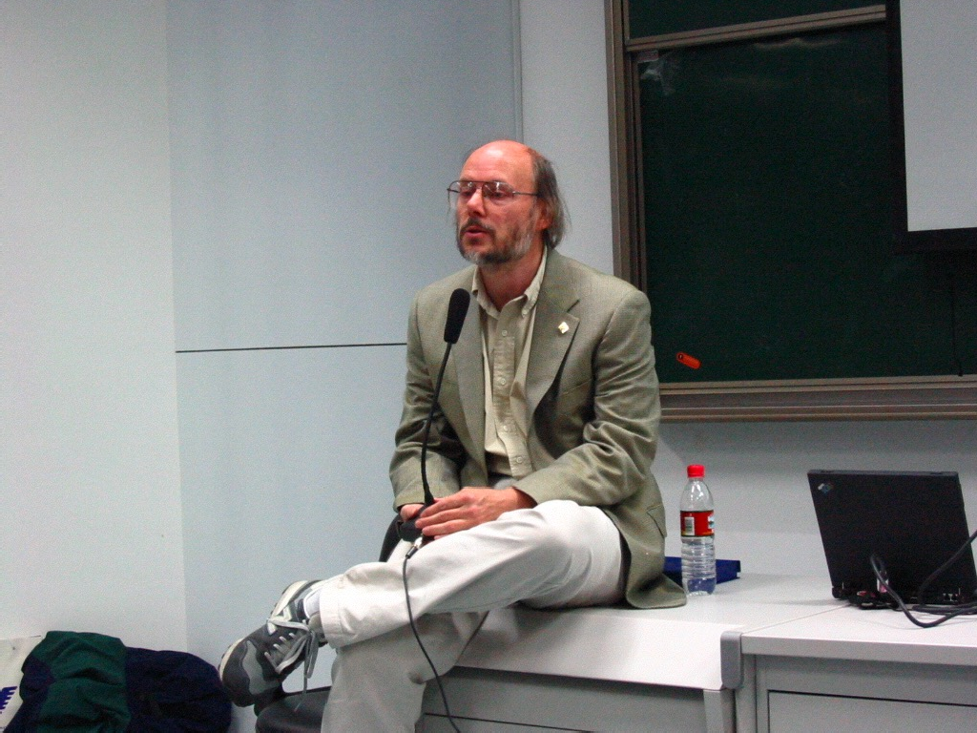

Slide 38
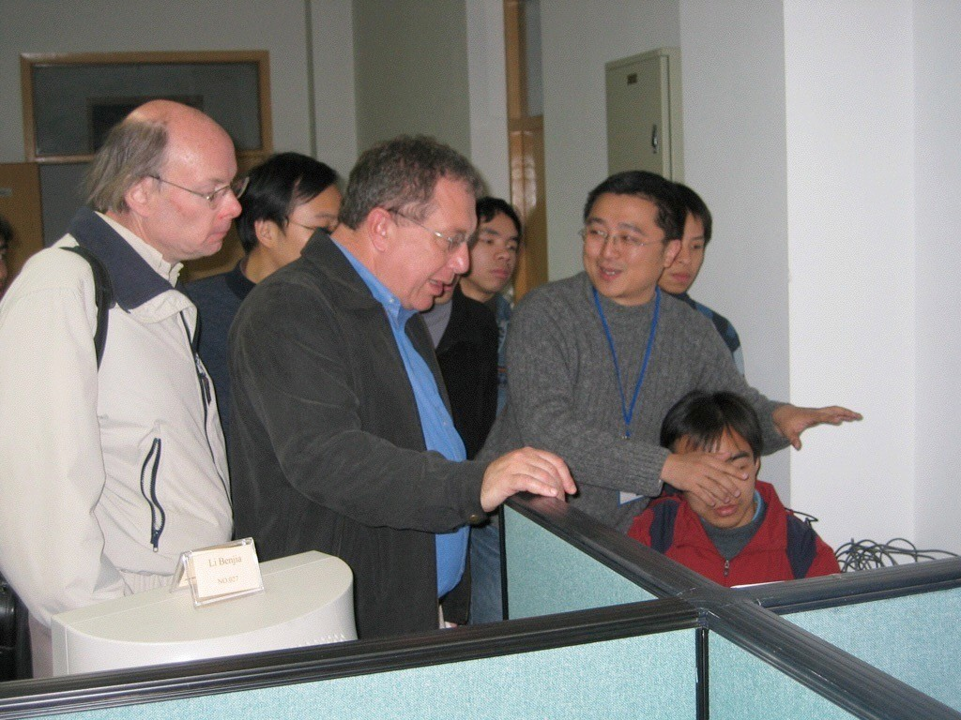
Stroustrup visited zju in 2005

Slide 39
C++ 之父：爱吃辣子鸡，C++20 会非常出色
https://www.infoq.cn/article/rv3SX2V8rtRaJj9B17xZ

Slide 40
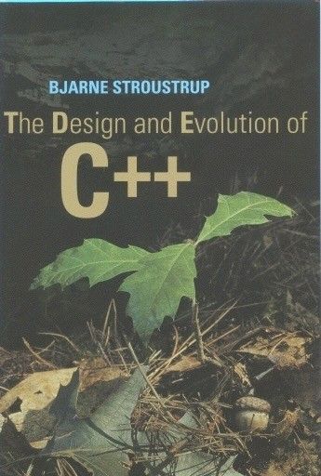
The Design and Evolution of C++
Bjarne Stroustrup, Addison-Wesley, ISBN 0-201-54330-3

Slide 41
Brief history of C++ (1)
1978: BS at Cambridge, UK. Simulation program in Simula
Supports classes, inheritance, and type check
Poor performance
http://www.engin.umd.umich.edu/CIS/course.des/cis400/simula/simula.html

Slide 42
Brief history of C++ (2)
1979: BS at AT&T Labs, Cpre, C w/classes
1980: most C++ features but virtual functions
1983: C++ w/virtual functions, named C++ by Rick Mascitti
1985: “The C++ Programming Language”
1990: ANSI C++ Committee ISO/ANSI
Standard C++ in 1998: ISO/IEC 14882 (http://www.open-std.org/jtc1/sc22/wg21/)

Slide 43
Brief history of C++ (3)
C++03, C++11, c++14, c++17, c++20
To be continued …

Slide 44
Goal for C++
To combine:
Flexibility and efficiency of C
Support for object-oriented programming (from Simula and SmallTalk)

Slide 45
C and C++
C
C++
C++ builds on C
Knowledge of C helps you in C++
C++ support more styles of programming
C++ provides more features

Slide 46
C++ improvements
•
•
•
•
•
•
•
•
•
•
•
•
•
•
•
Data abstraction
References
Access control
Operator overloading
Initialization & cleanup
More safe and powerful memory management
Function overloading
Support for OOP
Streams for I/O
Templates
Constants (C99)
Exception handling
Name control
More extensive libraries, STL
Inline functions(C99)

Slide 47
C++ can be viewed as a “better” C
C++
• C++ => C=C+1
but...
C++ is not C
Focus on C++ as a language in its own right
C++ is a hybrid language, supports
Procedure-oriented programming
Object-oriented programming
Generic programming

Slide 48
Criticism of …
C++
https://en.wikipedia.org/wiki/C%2B%2B#Criticism
OOP
https://en.wikipedia.org/wiki/Object-oriented_programming#Criticism

